Slide 1
Title
University Of Karachi
Department Of Computer Science
Group Members:
Course Supervisor: Dr. Humera Tariq

Slide 2
Content Organization
Problem Statement
Why It is important to Solve the Chosen Problem/Real life use cases
High level Context Diagram
Input Data Acquisition and Format details
Expected outcome / Success criteria / Output screen shots
Proper Module Wise Labelled Block Diagram /Work flow
Intermediate Results ( Images / comparison tables/graphs /statistics)
GUI / client side view
Preprocessing Details
Key Algorithm ( Your contribution and Innovation)
Challenges/ Difficulties
Learning and Achievements
Improvements needed and/or Future Work
References (Recent and authentic)
Team members profile along with work break down
Demo and Viva

Slide 3
Problem Statement
The objective of the project is to………………………………………………………

Slide 4
Importance
To Solve the given Problem is important because ………………………………………………………

Slide 5
Data Acquisition
In this section we describe that how we acquire input images / Video for processing. Input Images are also shown to understand the addressed Problem.

Slide 8
Block Diagram/Flow of Work
In this Section we described with the help of Block Diagram, the principles we studied and apply to input images to address the mentioned problem.

Slide 11
GUI
In this section we show our GUI so that viewers can understand the interaction in between input and output.

Slide 12
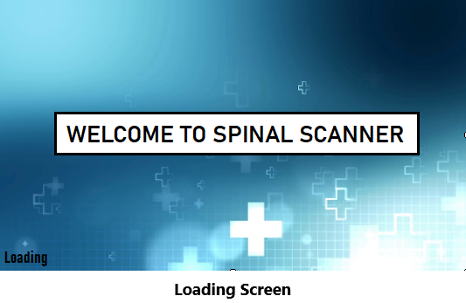
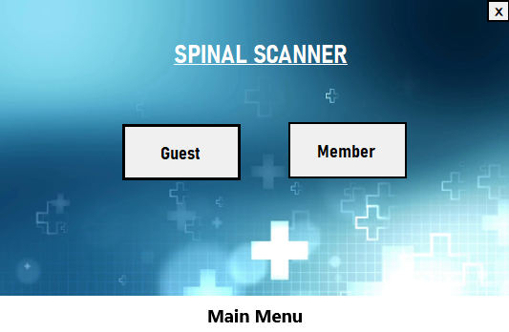
Guest user and Member
Guest user can perform detection of single image without logging in.
Member must have an account or register before using scanner and also perform detection on multiple images.

Slide 13
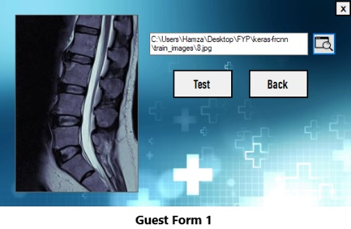
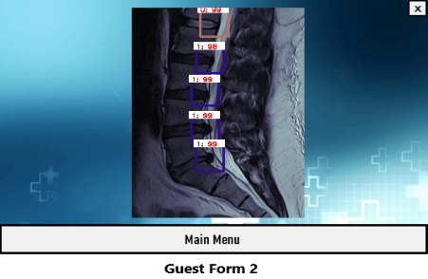
Browse image and begin testing.
Result image showing:
1 : xx = Defect : Probability
0 : xx = Fine : Probabilty

Slide 14
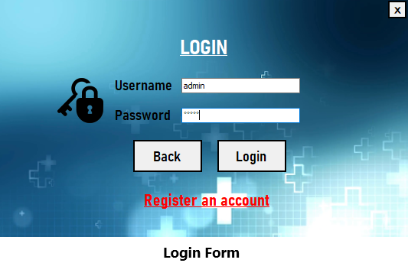
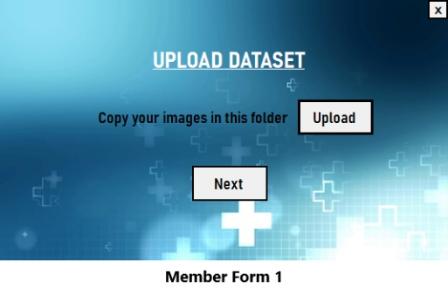
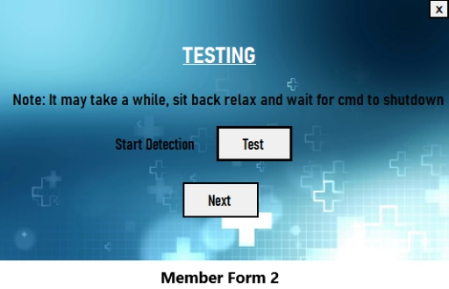
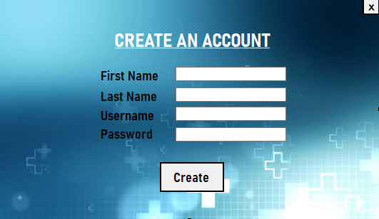
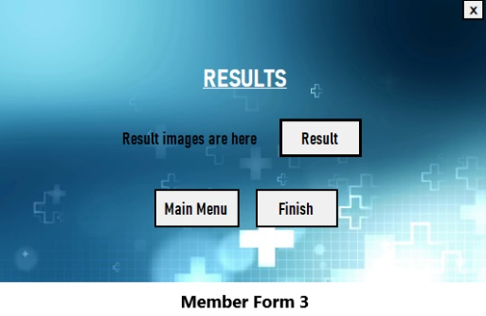
Upload images in folder.
Login with username and password / register.
Begin Testing.
Click Result button and folder containing result images pop-up.
Register Account.

Slide 15
Results
Before getting into the theoretical/Mathematical details we will show viewers some important results to grasp the techniques and concepts.

Slide 18
Preprrocssing
In this Section we described the preprocessing applied on input images along with necessary matlab code.

Slide 19



Image Format
Original format : .ima / .dicom ( Image Size = 200 – 300 kb )
Converted format : .jpg ( Image Size = 20 – 30 kb )
Normalization
$Xnorm=\frac{X − min\left(X\right)}{max\left(X\right) − min(X)}$

Slide 20

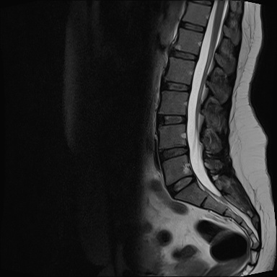
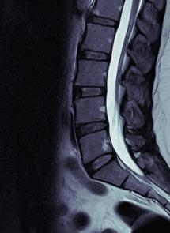
Cropping & Resizing
Original image resolution : ( 320 × 320 )
After cropping : ( 195 × 270 )
Final Image Size
12 - 15 kilobytes
195 × 270
320 × 320

Slide 21
Algorithm Description
Here we describes the key steps of algorithm that we used for image segmentation and/Or Feature Extraction

Slide 23
Learning and Achievements
In this section we describe the things that makes us feel that we have learned, we did something new , we did something that is different and thus we should get full marks or even we deserves Bonus marks.

Slide 24
The Idea is new because there are no similar projects available as we have searched through the internet about spinal stenosis detection.
At the start of project we only had knowledge about Artificial Intelligence in Data Science mostly.
As we proceeded in project we learnt about Computer Vision and Object Detection.
We also learnt about the disease Spinal Stenosis and how it can be diagnosed through MRI.
We deserve full marks because of our hard work and dedication to our project. As we have worked accordingly with your guidelines
We deserve bonus marks as we measure up to your expectations.

Slide 25
Improvements and future work
In this section we mention the tasks that are still unresolved. The exceptional cases where still improvement is needed. We also mention the applications that can build on top of our current work.

Slide 27
Demo and Queries

